Slide 1
Insurance Claim Prediction Using Logistic Regression

Slide 2
Introduction
Logistic regression is a technique used for solving the classification problem.
Insurance claim prediction is the process of using data analytics and machine learning techniques to forecast the likelihood and severity of future insurance claims. By analyzing historical data.

Slide 3
The problem
Ultimately, insurance claim prediction contributes to more accurate risk assessment and more efficient allocation of resources within the insurance industry.
Insurance companies can better anticipate potential risks and adjust their pricing, underwriting, and risk management strategies accordingly. This predictive modeling helps insurers optimize their operations, improve customer service, and mitigate financial losses by identifying high-risk policies or customers early on.

Slide 4
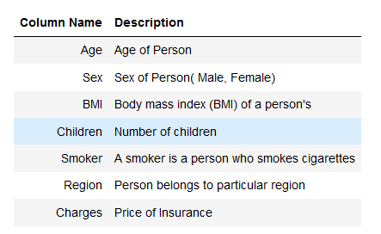
Data Description

Slide 5
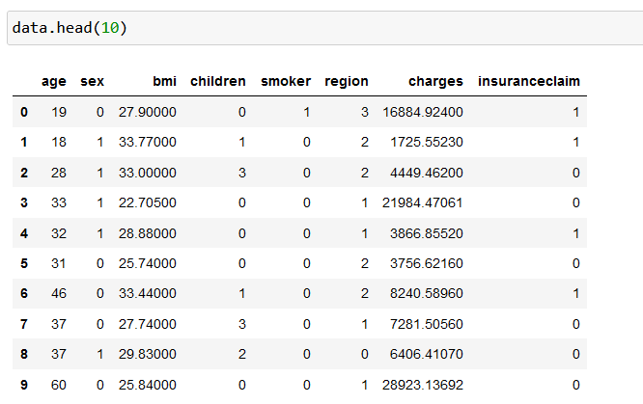
Data Information

Slide 6
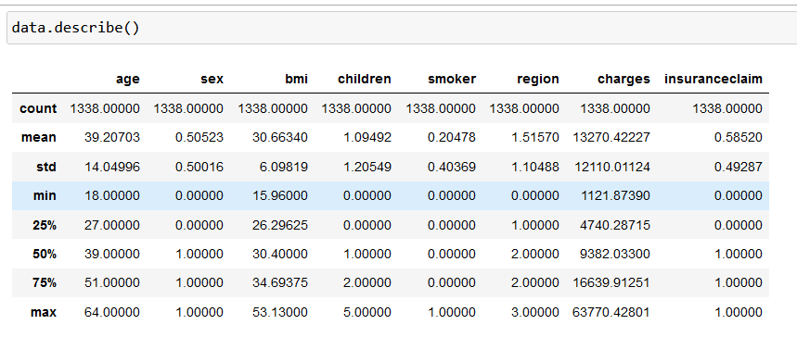
Data Statistics

Slide 7
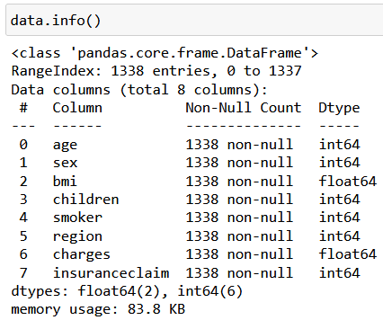
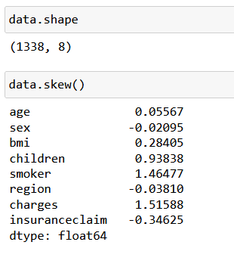

Slide 8
Observation
This dataset contains 1338 rows and 8 columns
There are ** No null values present**Each feature seems to have correct data type
The average age of the people is about 39 years.
Minimum age seems to be 18 years. Where, the Max age was 64.
The average Charges was 13270,Minimum charges seems to be 1338. Where, the Max charges is 63770 indicates its skewed.

Slide 9
Exploratory Data Analysis

Slide 10
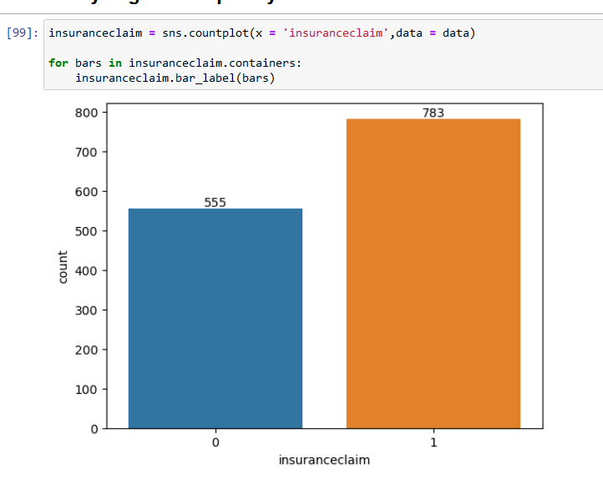
Analyzing the Frequency of Insurance Claims:
Observation:
We can observe 778 people clamed.

Slide 11
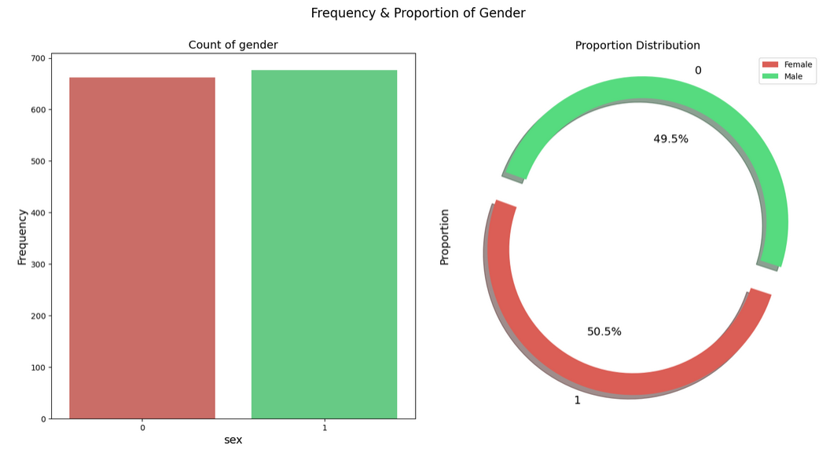
Gender Distribution: Analyzing the Count of Genders:
Observation:
The count of males and females is nearly equal.

Slide 12
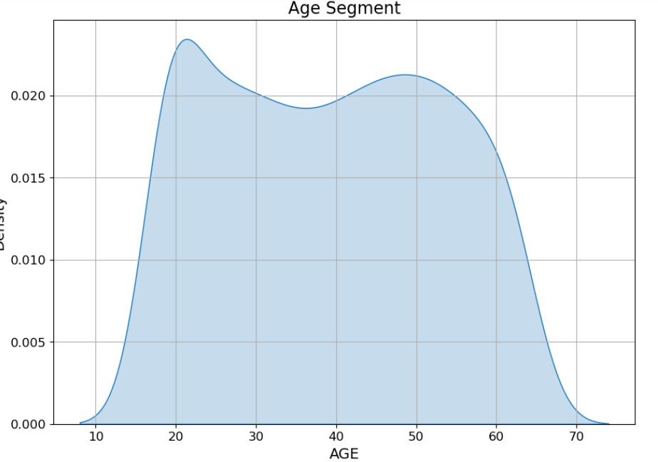
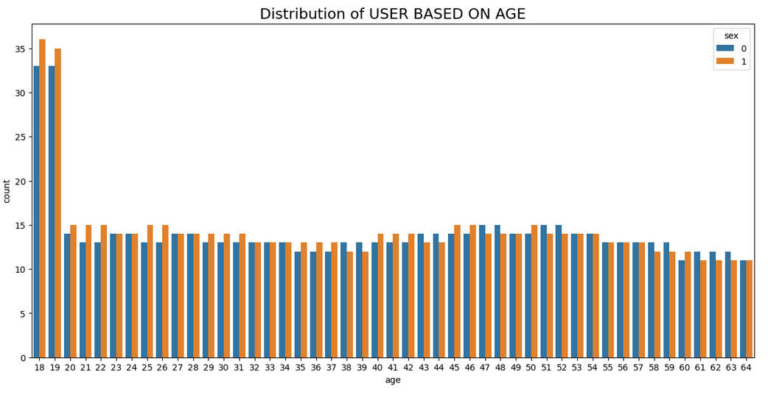
Age Segments
Observation:
Minimum age seems to be 18 years. Where, the Max age was 64.

Slide 13
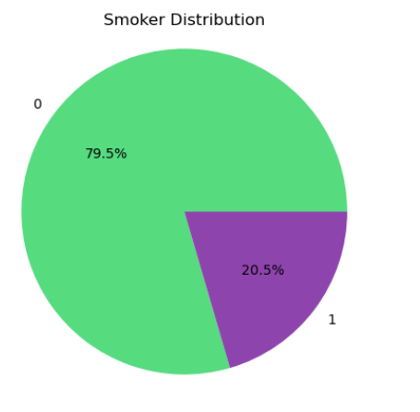
Analyzing the Count of Smokers
Observation:
We can **observe** 20.5% people are smoker..

Slide 14
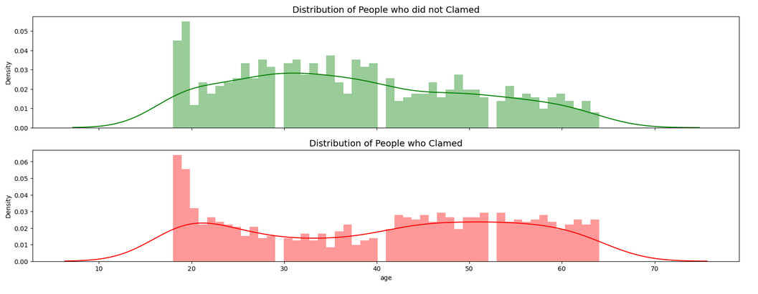
Association between Age and Clame
Observation:
We can see that the distribution of both the cases are similar.
If you notice the second graph you will see a little rise in the bar at the Age from 55-65 of the graphs.

Slide 15
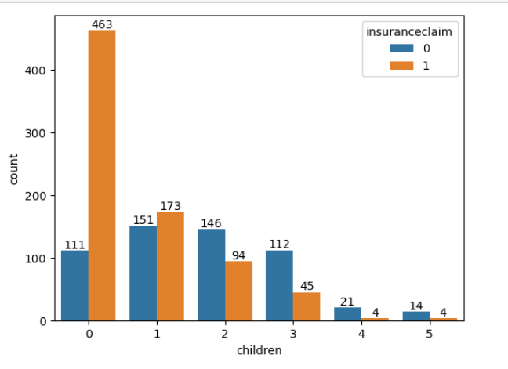
Demonstrate an individual's insurance claim alongside the count of their dependents.
Observation:
The distribution analysis uncovers a notable pattern wherein the dependent segment ranging from 0 to 1 shows a notably higher count compared to other dependent segments.

Slide 16
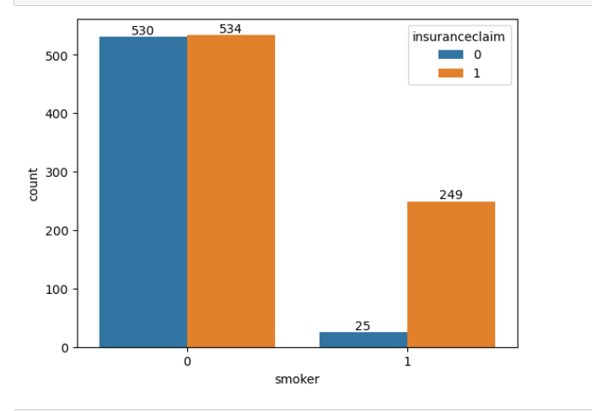
Claim for personal insurance from an individual who is a smoker

Slide 17
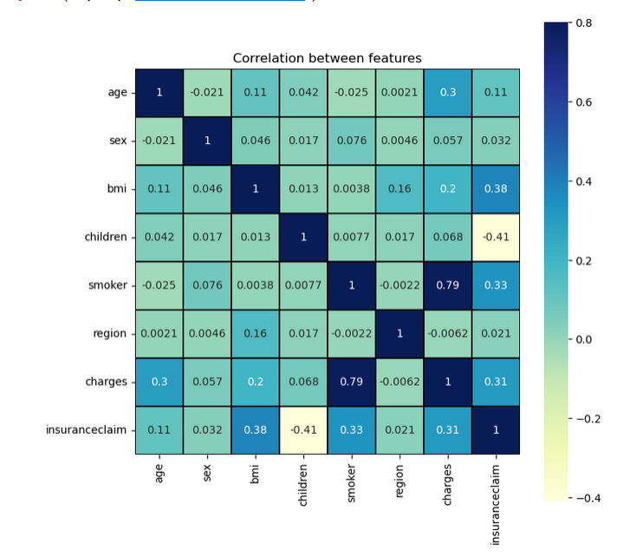
Feature Selection-(Correlation between Features)
Observation:
Children are Insuranceclame are –negatively corelated with Clam.
Smoker and Charges are positively correlated with clam.

Slide 18
Model Development & Evaluation
max growth
Logistic Regression

Slide 19
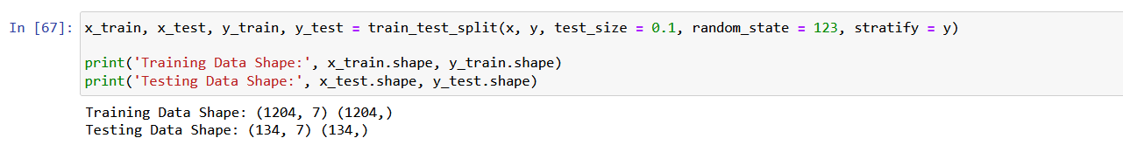
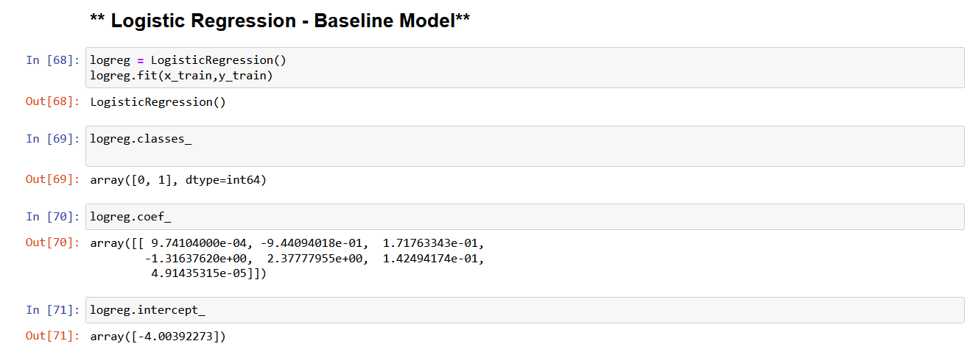
Split Data in training and testing.&Logistic Regression - Baseline Model

Slide 20
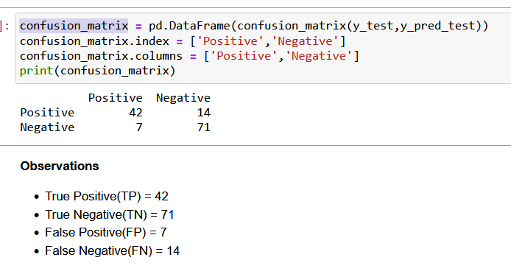
Model Evaluation On Test Data (confusion_matrix)

Slide 21
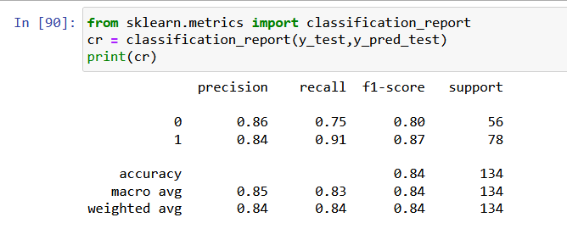
Classification Report

Slide 22
Conclusion
We studied in briefly about the data, its characteristics and its distribution.
We explored some questions related to Clams.
We investigated in depth about the features which to retain and which to discard.
We performed model training.
We observed metrics for our prediction.
This model With accuracy score of 82% now can help us in identifying who survived and who did not survive.
Accuracy score of 82%

Slide 23
Thank You
Contributions are always welcome! Please give your important and valuable review
Kindly reach out to me at abhishek.ajit.thakur@gmail.com
Want to connect with me? Check out these links:👉
👉 LinkedIn: https://lnkd.in/ewnTuds9
👉Github: https://lnkd.in/dwdXai-G

